Slide 1
Nonlinear Pipelining
Compiled by
Dr. N. Gopalakrishna Kini
Professor, Dept. of CSE
MIT, Manipal

Slide 2
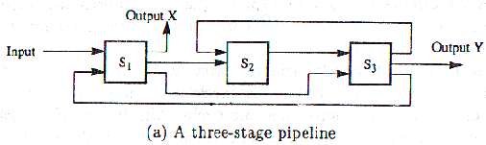
Nonlinear Pipelining
Linear pipelines are static pipelines because they are used to perform fixed functions.
Nonlinear pipeline: Which allows feedback and feed forward connections in addition to streamline connections.

Slide 3
Nonlinear Pipelining
Reservation tables are two-dimensional charts used to show how successive pipeline stages are utilized (or reserved) for a specific function evaluation in successive pipeline cycles.
Let X & Y be two functions evaluating in the above pipeline.
1
2
3
4
5
6
7
8
1
2
3
4
5
6
S₁
S₁
S₂
S₂
S₃
S₃
Reservation table for function X
Reservation table for function Y

Slide 4
Nonlinear Pipelining
Latency Analysis
Latency: number of time units (clock cycles) between two initiations of a pipeline is the latency between them.
Latency of k means that two initiations are separated by k clock cycles
Collision:an attempt by two or more initiations to use the same pipeline stage at the same time.

Slide 5
Nonlinear Pipelining
Latency Analysis
Forbidden latency: that causes collision.
Permissible latency: that doesn’t.
In the previous example 2 and 5 were forbidden latencies.
With the help of these latencies we will find out the minimal average latency (MAL) that will give maximum efficiency of pipeline without collisions.
The method is called “Collision-free scheduling”.

Slide 6
Nonlinear Pipelining
Latency Analysis
Formal Methods to find out Permissible & Forbidden Latencies:
To detect a forbidden latency, find out the distance between any two check marks in the same row of the reservation table and the rest are permissible latencies.
Q. Find out permissible and forbidden latencies of the reservation table for function x.
F.L_{x} = 2,4,5,7
P.L_{x} = 1,3,6,8

Slide 7
Nonlinear Pipelining
Latency Analysis
Collision-free Scheduling:
Let us first look at some basic terms:
Latency sequence: a latency sequence is a sequence of permissible latencies between successive tasks initiations.
Latency cycle:is a latency sequence which repeats itself.

Slide 8
Nonlinear Pipelining
Latency Analysis
Constant cycle: which contains a single latency value.
State diagram: will be used here to specify the permissible state transitions among successive tasks initiations.
Collision vector: (collision array) is a combined set of permissible and forbidden latencies.
C = ( C_{m} C_{m-1} …… C₂ C₁ )

Slide 9
Nonlinear Pipelining
Latency Analysis
Construction of the state diagram:
Collision vector is the initial position vector or the starting state of the sate diagram.
C_{x} = 1011010
Next state is obtained by right shifting the zeros of current state and then OR-ing the result with collision vector.

Slide 10

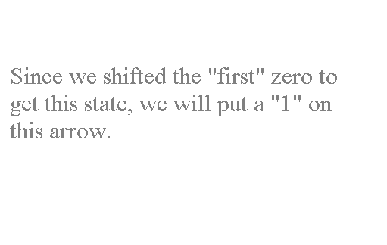







Nonlinear Pipelining
Latency Analysis
First bit (zero bit) to be right shifted
1011010
Starting state
1111111
Current state.

Slide 11








Nonlinear Pipelining
Latency Analysis
1011010
1011011
1111111

Slide 12



Nonlinear Pipelining
Latency Analysis
1011010
1011011
1111111
Now, right shift the sixth bit and see what you get after ORing it with the start state..

Slide 13
Nonlinear Pipelining
Latency Analysis
1011010
1011011
1111111
Since there are no more zeros left in this state to be right, lets move on to the next state.
Now this state is our current state.

Slide 14
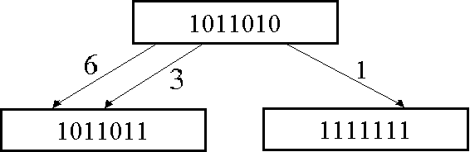

Nonlinear Pipelining
Latency Analysis
So we get,
In this state we don’t have any zeros, so we move on to the next state. As our current state.
Right shifting and ORing of the third and sixth bit gives the same state again.

Slide 15

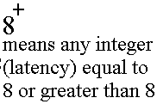

Nonlinear Pipelining
Latency Analysis
1011010
1011011
1111111
One last thing, when the number of shifts is m+1 (m: maximum forbidden latency), all the transitions are redirected back to initial state.

Slide 16
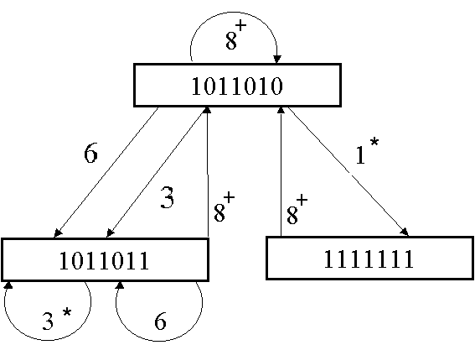
Nonlinear Pipelining
Latency Analysis
Our state diagram is complete now.
This state diagram is used to characterize successive initiations of tasks in the pipeline in
order to find the shortest latency sequence to optimize the control strategy.
A state on the diagram is representing the contents of shift register after proper no. of shifts is made, which is equal to the latency between the current and next task initiations.

Slide 17
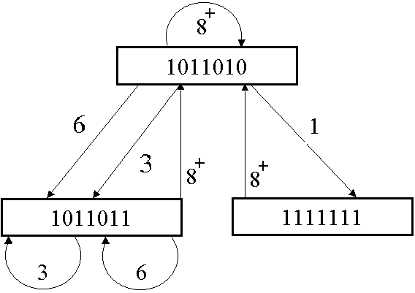
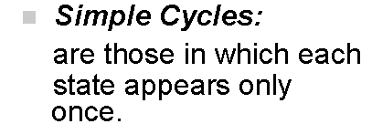






Nonlinear Pipelining
Latency Analysis
The next step is to write the simple latency cycles.
Some of these are called greedy cycles

Slide 18




Nonlinear Pipelining
Latency Analysis
Greedy Cycles: are those ones whose edges are all made with minimum latencies from their respective states (ones with *) .

Slide 19
Nonlinear Pipelining
Efficiency of Nonlinear Pipelining:
We find the efficiency of nonlinear pipeline using greedy cycle corresponding to MAL.
100% efficiency: when all the stages of pipeline are always busy.
From the above example, if we do the initializations with MAL i.e, 3. We get the efficiency as follows:

Slide 20


efficiency: η = x 100
η = x 100
= 88.89%
Q. Calculate efficiency for the same pipeline with greedy cycle (1,8).

